Slide 1

CodeWave

Slide 2


Motivation and Progress Challenges
Understanding the hurdles that learners face daily
Many learners struggle with motivation and tracking progress, leading to frustration and drop-off. CodeWave addresses these pain points with a structured and supportive learning journey.

Slide 3
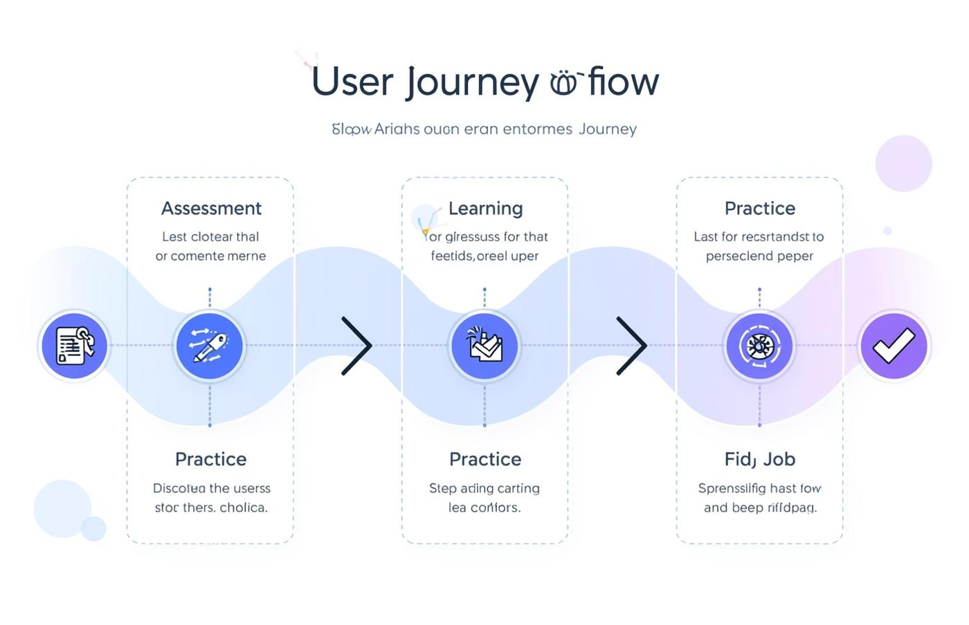
Solution Overview: Personalized Learning for Career Success
User Journey
A seamless path from learning to employment opportunities.

Slide 4
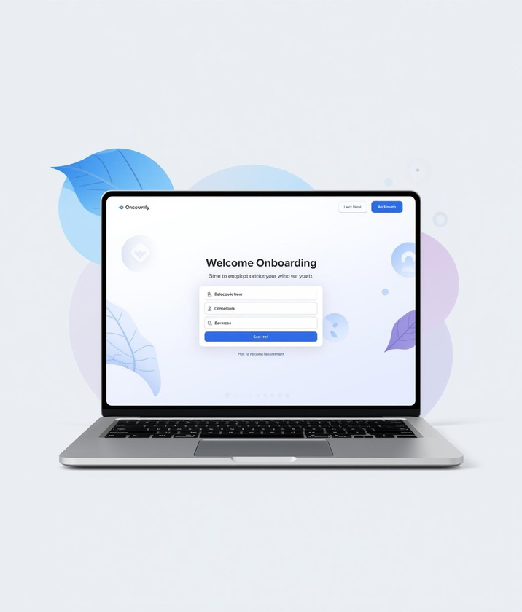
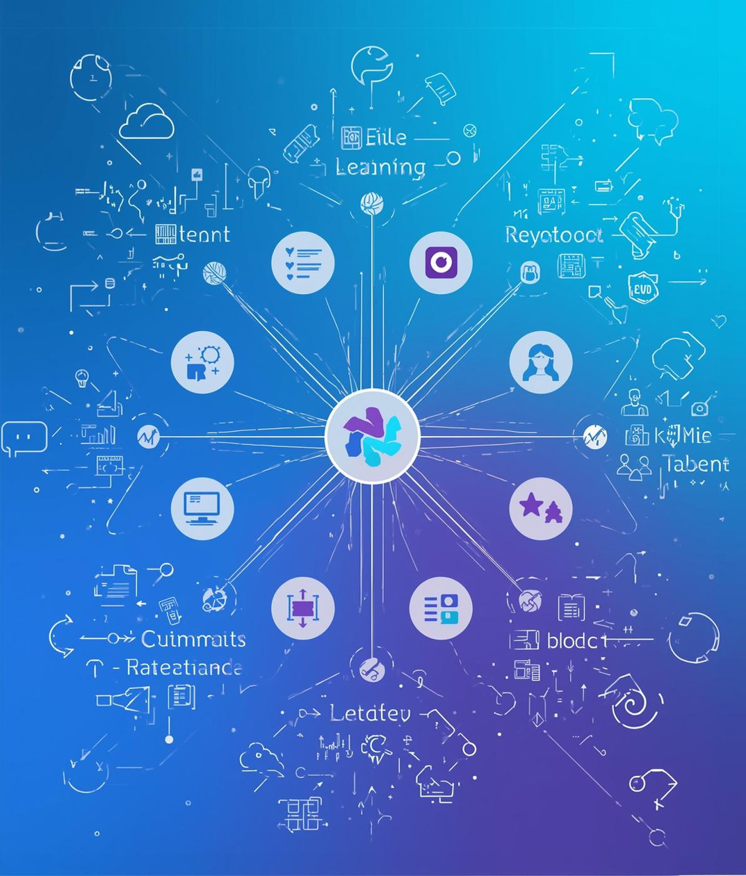


Core Features of CodeWave
Onboarding
Learning Paths
Interactive Lessons
Career Connection
Personalized assessment for learner's journey
Structured modules for skill development
Hands-on coding tasks with instant feedback
CV-building and job offer matching

Slide 5
User Flow
2026
2027
2028
Initial assessment completed
Courses and projects started
Job applications submitted

Slide 6
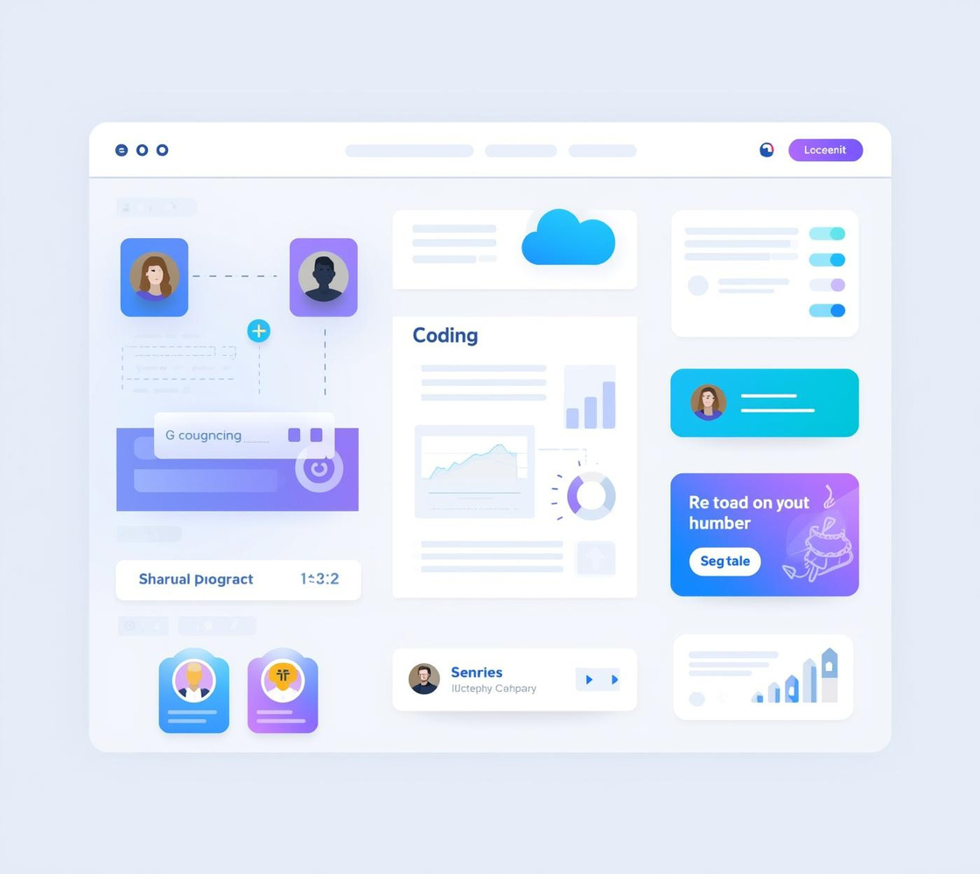


System Architecture
Frontend UI
Backend API
Learning Engine
User-friendly interface for learning and tracking
Manages user authentication and content delivery
Facilitates assessments and personalized learning paths

Slide 7
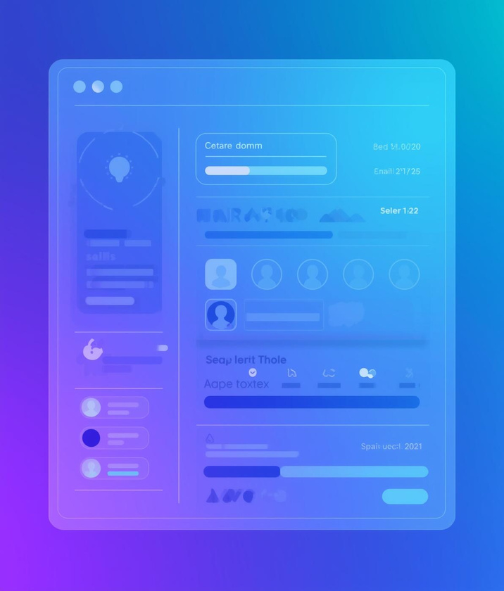
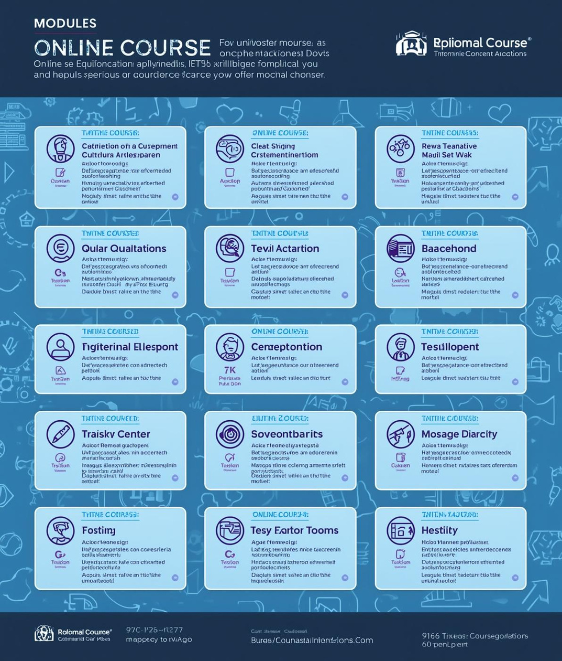
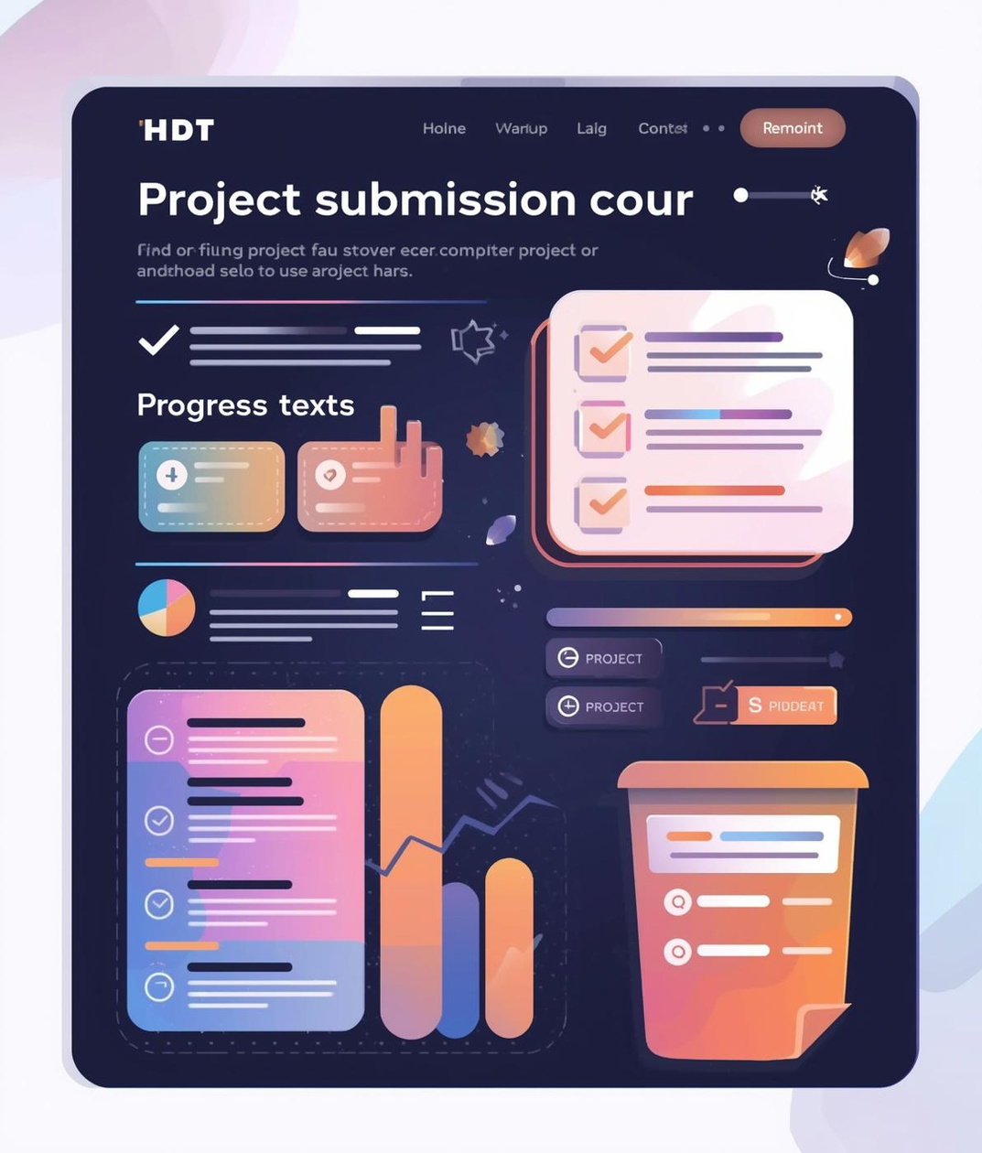
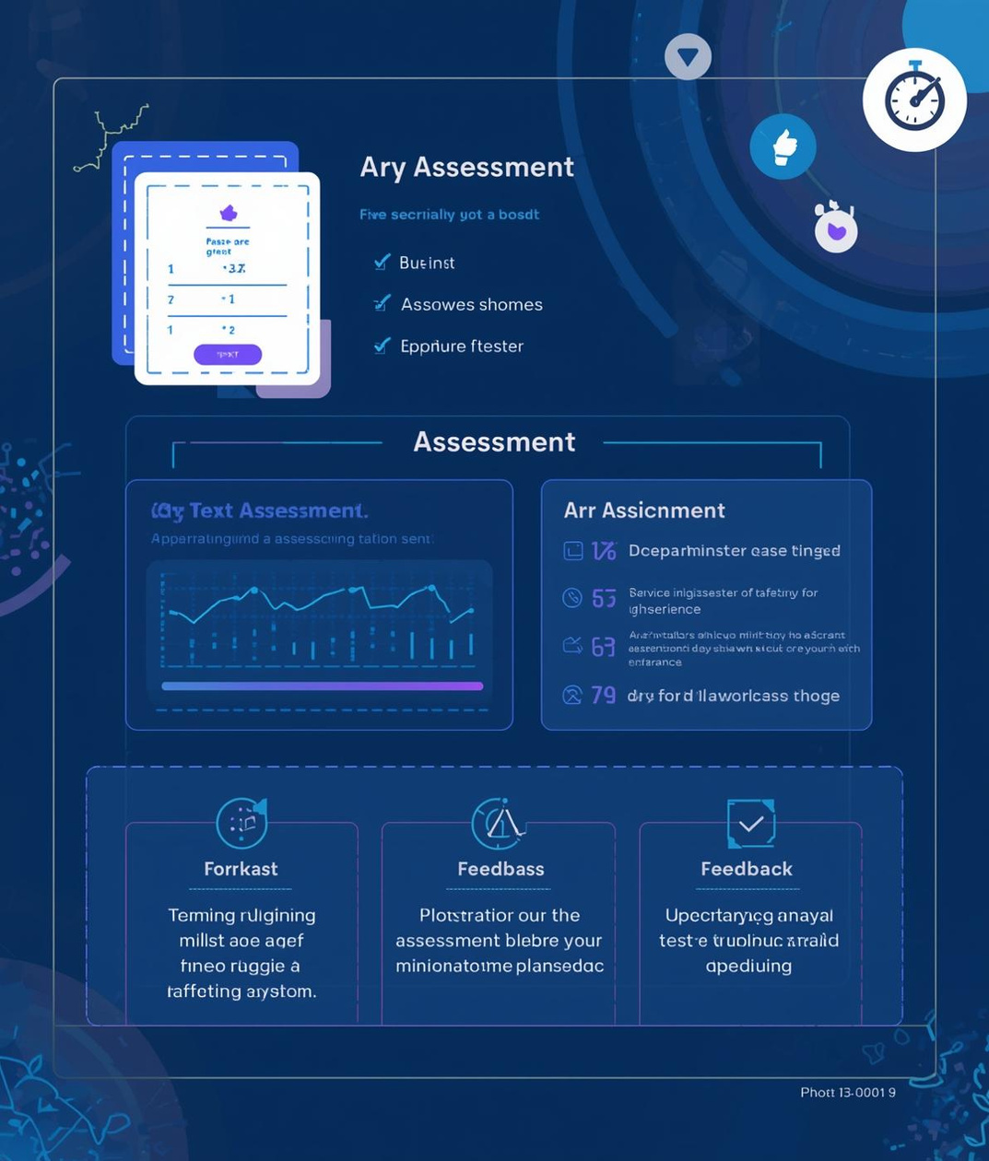
Database Model: Key Entities and Relationships
User
Course
Project
Assessment
Profiles track learner progress and levels
Learning paths contain structured content modules
Submissions linked to real-world scenarios
Initial tests track skills and progress

Slide 8
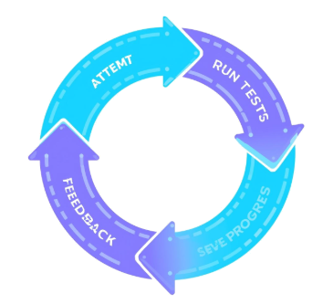

Feedback Loop
Continuous Improvement
Instant feedback helps learners improve quickly.
Real-World Projects
Projects simulate hands-on scenarios and tasks.

Slide 9
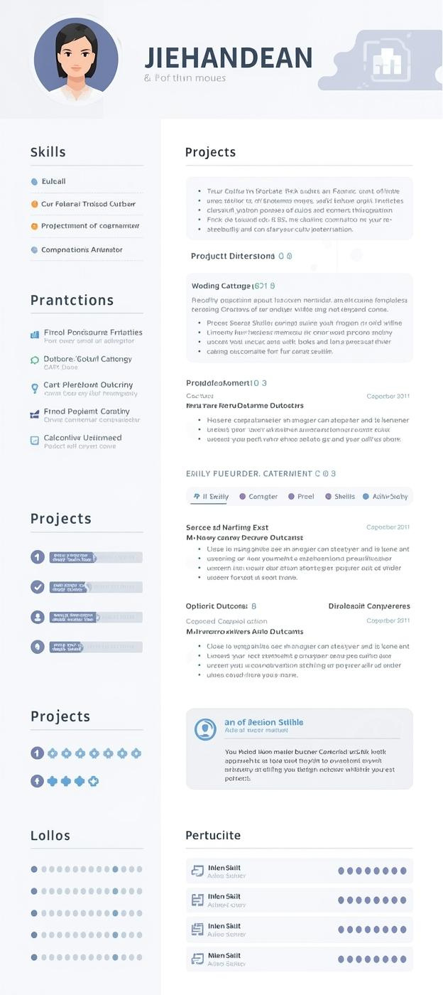
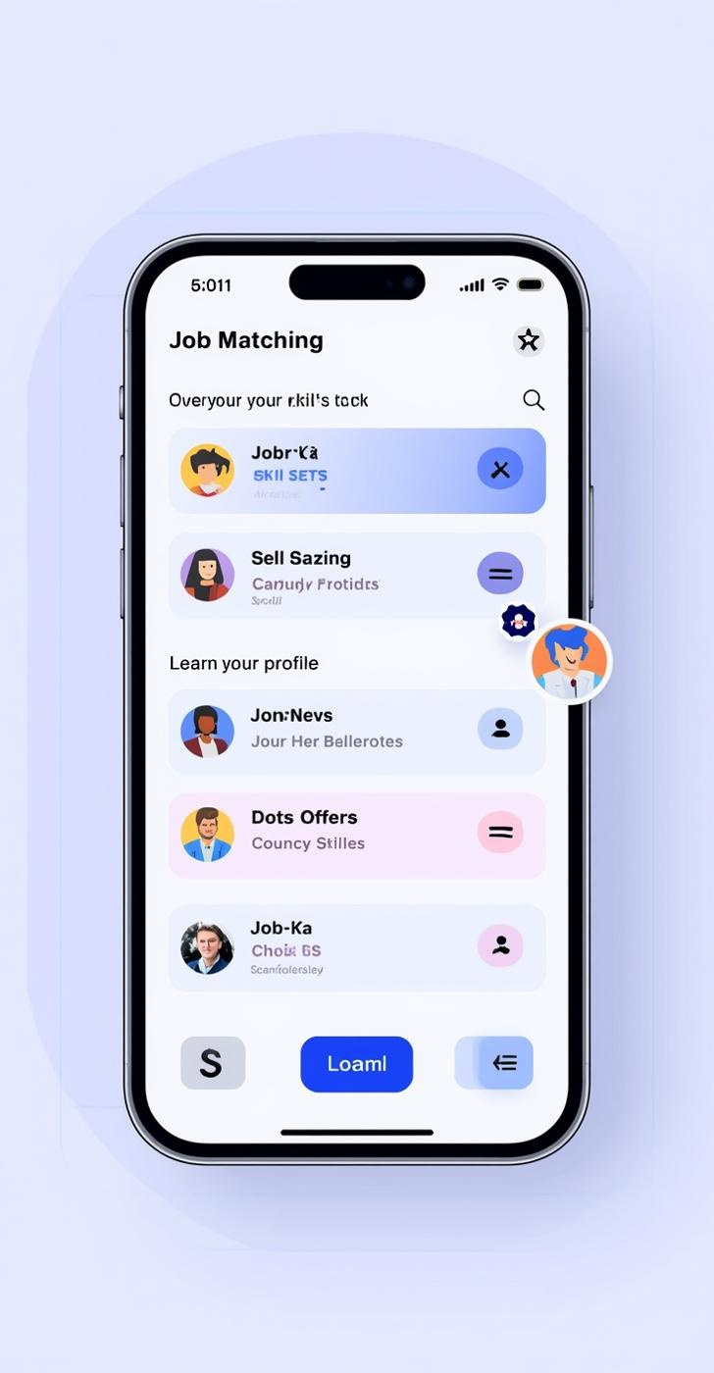
Career Features
Auto-generated CVs and personalized job matching services
CodeWave connects learners to career opportunities by auto-generating CVs based on completed courses and projects, while providing tailored job recommendations to enhance employability.

Slide 10


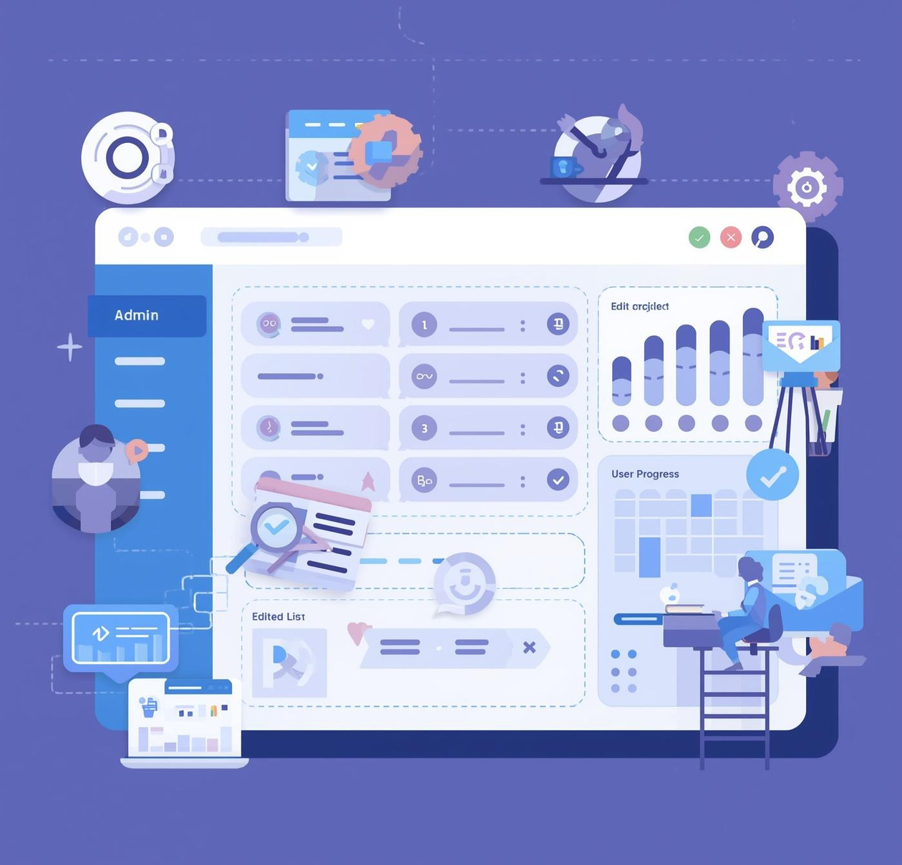
Admin Panel Overview
Managing Content and Engagement for Optimal Learning
The admin panel is designed to streamline the management of users, courses, and engagement metrics, ensuring quality control and continuous improvement of the learning experience.

Slide 11





Security
Personalization
Quality
Scalability
Privacy
Ensuring safe execution of user code.
Enhancing engagement through tailored learning paths.
Maintaining consistent and high-quality curriculum.
Supporting growth through modular architecture.
Protecting user data with strong measures.
Key Challenges and Solutions

Slide 12
WEBSITE
codewave.com
Thankyou :)
Get in Touch with CodeWave Team
Any Question?
COURSE NAME
Application Development COMP420
TEAM
Nour Hamoud - Fatima Mansour
Haidar Al-Mokdad

